Slide 1
Apple Vision Glasses
By: Arman Abir, Lauren Cali, Yifan Chen, Krystal Contreras, Jacob Loshinsky, Maxim Zarkhin

Slide 2
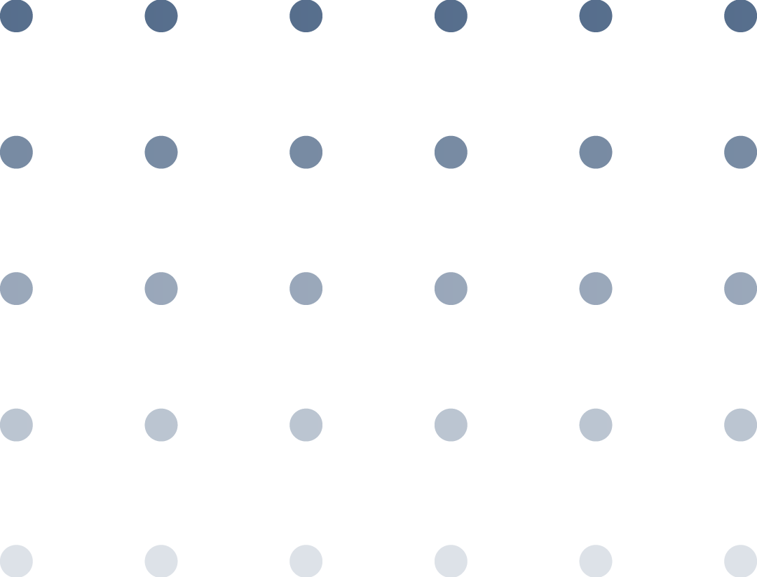
01
Product
Description

Slide 3
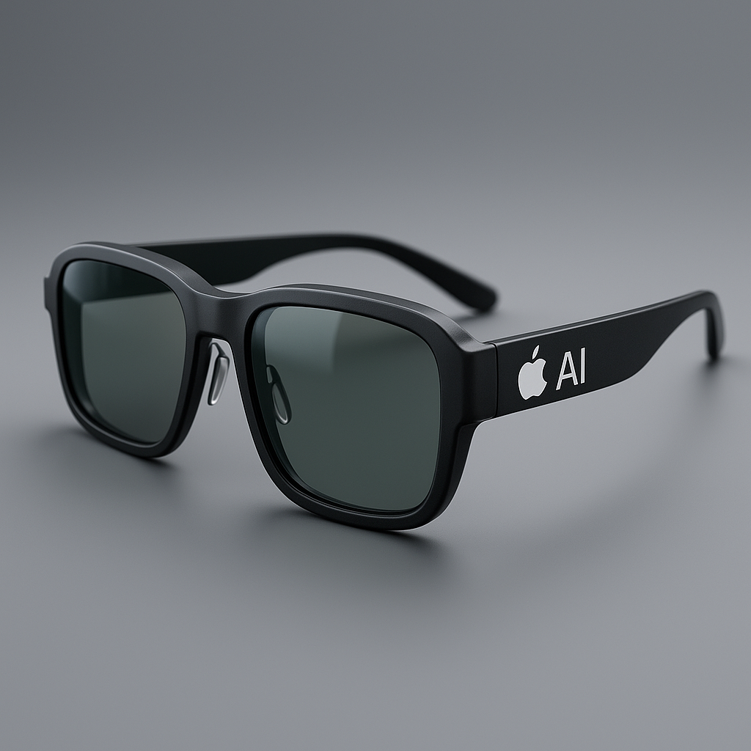
Product Description and Benefits
Lightweight AR-enabled eyewear
Transparent micro-OLED display
Siri voice control + eye-tracking
Syncs with iPhone, Watch, AirPods
Navigation overlays, notifications, translation
Built-in camera + fitness tracking
Local processing for privacy

Slide 4
Benefits
Hands-free access to information
Improved productivity
Real-time AR overlays
Fitness + Health integration
Enhanced entertainment
Seamless Apple ecosystem experience

Slide 5
Critique of Product Description
Fit within Apple’s existing portfolio
Apple has already built a high-value ecosystem.
Smart Glasses extend its wearable strategy, focusing on light augmented reality instead of full mixed reality.
It complements the vision pro
Partial advantage: It can easily integrate to existing apple users
Highly competitive emerging market (Meta, Snap, Samsung).
Hardware alone is not a durable advantage — software ecosystem and App Store support matter more.

Slide 6
02
Target
Market

Slide 7
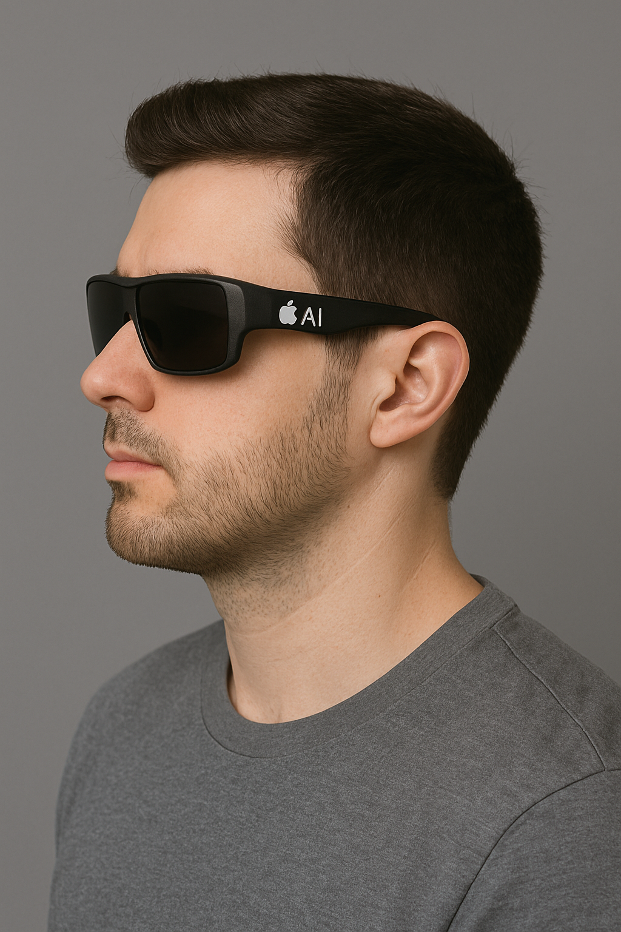
Target Marketing and Positioning (AI)
AI Target Segment
Primary - Tech-savvy young professionals (25–40), early adopters, innovators
Secondary - Students, creatives, fitness enthusiasts
Geographic - Urban areas with high-adoption areas
Psychographics - People who prioritize convenience, productivity, and innovation
Positioning Statement (AI)
“Apple Smart Glasses — See the world smarter.”

Slide 8
Critique Of Target Market
The customer base is well-defined and aligned with Apple's core customers.
Young professionals form a powerful early market.
But still a niche group → limits initial mass adoption
Works for the first-generation launch, but long-term growth to schools, medical facilities, and enterprise is needed.

Slide 9
Critique: How would the Market React?
Most likely positive response due to enthusiasm in innovation and new technological experiences.
Trust in the Apple environment leads to better adoption.
However, there are potential issues:
-Wearing AR glasses in public
-Privacy concerns with visible cameras
-High price point limiting accessibility

Slide 10
Critique: Does Apple have experience with this Target Market?
-Yes, the same audience has adopted:
Apple Watch
AirPods
iPhone Pro / MacBook Pro
-Apple excels at launching premium devices for tech-savvy people.
-Proven track record of converting early adopters into influencers, which supports targeted strategy.

Slide 11
Critique: Is the targeting strategy appropriate?
Yes but the strategy they use is micromarketing
Each product would fit and cater to customer needs allowing comfortability
Customers are satisfied with their if the product is catered to them

Slide 12
03
Market Mix
Strategy

Slide 13
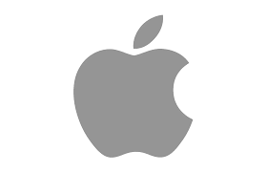
Product Name & Identity
AI Recommendation
“Apple Smart Glasses”
Simple, descriptive
Matches older Apple naming style
Our Critique
Too generic
Doesn’t match modern Apple branding (Vision Pro, AirPods, AirTag)
Lacks long-term brand identity
→ Better names: Apple Vision Glass, Apple Lens, Apple View

Slide 14
Models, Sizes, Colors & Packaging
AI Recommendation
One basic model
Clear/tinted/prescription lenses
Neutral colors (black, silver, space gray)
Minimalist Apple packaging
Our Critique
Product Line
One model = too limited
Recommend Standard + Pro versions
Multiple frame sizes
More style-oriented color options
Packaging
Minimal is good, but needs more protection
Should include premium hard case
Should emphasize sustainability + premium feel

Slide 15
Overall Evaluation
Strengths of AI’s Strategy
Simple, clean foundation
Reasonable lens options
Fits Apple’s minimal aesthetic
What We Improve
Create a stronger, future-proof product name
Add product tiers (Standard/Pro)
Expand sizing & color options
Upgrade packaging for safety + luxury
Our approach aligns better with Apple’s premium brand and long-term ecosystem.

Slide 16
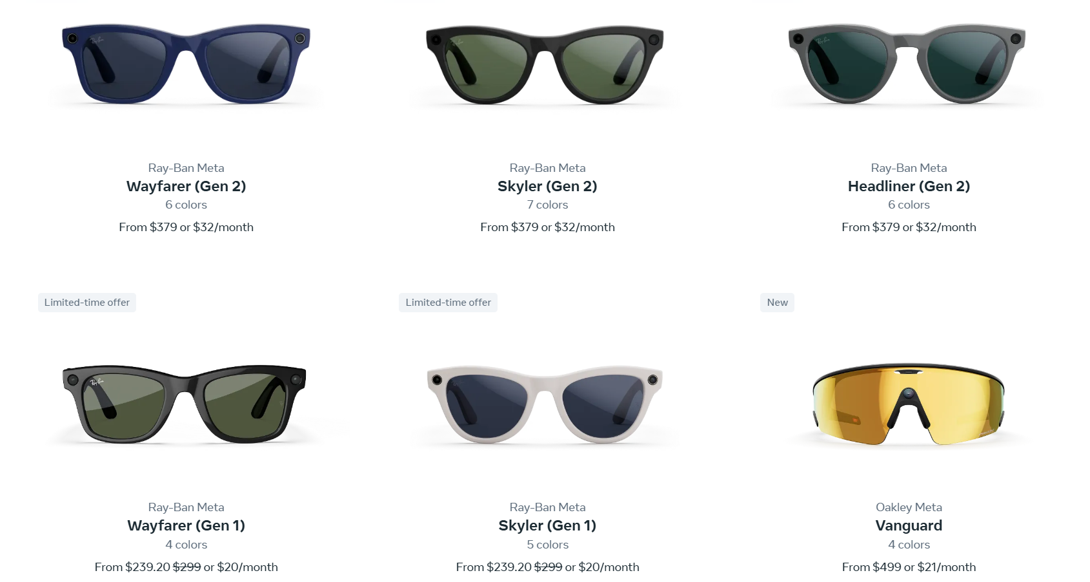
Price Strategy
Competitor: Meta’s Ray-Band AI Glasses
Luxury electronics market
Skimming pricing strategy would be better than premium
Meta and Samsung are only competition- Oligopoly
Recommended price should not exceed competitors
Importance of Early Adopters and Innovators
Eventual price decrease
Notes:
AI recommended premium pricing strategy- setting prices of $999 to $1,499 however we disagree.
Skimming- high prices to attract initial customers which I’ll mention in specific which type next
Meta owns 73% of the market share according to Flora Tang at Counterpoint Research
It should be noted that Apple has the brand awareness and resources to break into this industry (no penetration pricing) so they should at the very least float around Meta’s prices
Their current highest priced glasses are worth about $800.
Again with brand awareness this will mean that early adopters and innovators are vital to the success of Apple’s launch to encroach on Meta’s market share
One last thing to consider is that like a lot of electronic products prices will eventually come down as new technology comes out and this becomes outdated

Slide 17
Place Strategy (AI)
AI’s Distribution Strategy Recommendation:
Sell the glasses in the following locations:
Apple Store
Apple Website
Electronic Stores
Exclusive deals with Mobile Carrier Brick & Mortars
Our Critique:
In person → Lead to try-ons
Apple Website → Classic for loyal Apple customers to purchase
Electronic Stores like Best Buy allow for more people to try on, and bigger audience to reach
Exclusive Deals with mobile carriers are not optimal. Allow all carriers to sell
ADD: Wholesalers like Costco/BJ’s
Notes:
JACOB

Slide 18
Promotion Strategy (AI)
AI’s Advertising Strategy Recommendation:
For Digital Marketing:
Social Media
For Traditional Apple Marketing:
Yearly Apple KeyNote
Apple Billboards
AI’s Suggested Slogan
“Through Your Eyes — The Future is Here.”
Our Critique:
We believe all these marketing methods fit with the product, and the entire Apple ecosystem
We do not like this slogan - Apple is simplistic with less than 3 words
Notes:
JACOB
Social Media - YouTube, TikTok, IG, Use paid influencers
Apple Billboards- In metropolitan areas, ex. They buy ads in soho for their current products
For Slogan: We do not think the slogan is good. Apple tends to have a simplistic vibe to it. Past slogans like “Shot on Iphone” and “Think Different Again” are three words, very short and get to the point. We believe a better slogan would be more minimalist.

Slide 19
THANK YOU!

